Slide 1
ELEC 2200-002
Digital Logic Circuits
Fall 2008
Switching Algebra (Chapter 2)
Vishwani D. Agrawal
James J. Danaher Professor
Department of Electrical and Computer Engineering
Auburn University, Auburn, AL 36849
http://www.eng.auburn.edu/~vagrawal
vagrawal@eng.auburn.edu
Fall 2008, Sep 26 . . .
ELEC2200-002 Lecture 4

Slide 2

Switching Algebra
A Boolean algebra, where
  Set K contains just two elements, {0, 1}, also called {false, true}, or {off, on}, etc.
  Two operations are defined as, + ≡ OR, · ≡ AND.
+ | 0 | 1
0 | 0 | 1
1 | 1 | 1
· | 0 | 1
0 | 0 | 0
1 | 0 | 1
Fall 2008, Sep 26 . . .
ELEC2200-002 Lecture 4

Slide 3
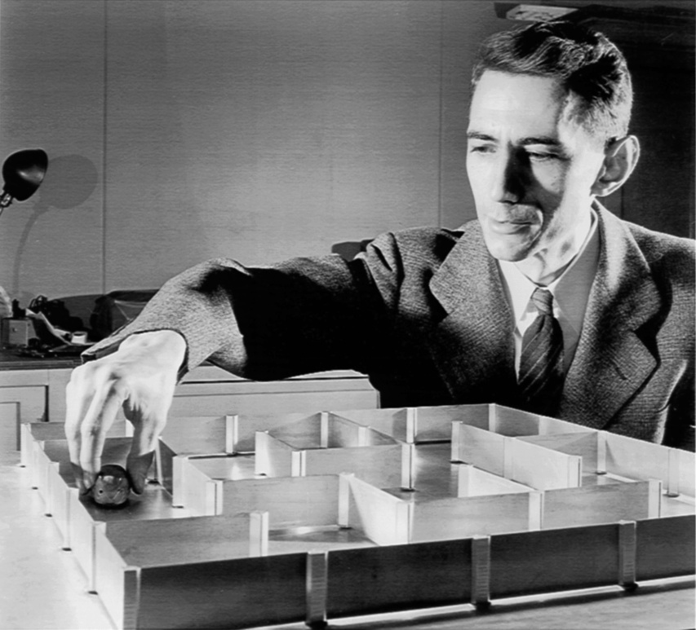
Claude E. Shannon (1916-2001)
http://www.kugelbahn.ch/sesam_e.htm
Fall 2008, Sep 26 . . .
ELEC2200-002 Lecture 4

Slide 4
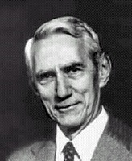
Shannon’s Legacy
A Symbolic Analysis of Relay and Switching Circuits, Master’s Thesis, MIT, 1940. Perhaps the most influential master’s thesis of the 20th century.
An Algebra for Theoretical Genetics, PhD Thesis, MIT, 1940.
Founded the field of Information Theory.
C. E. Shannon and W. Weaver, The Mathematical Theory of Communication, University of Illinois Press, 1949. A “must read.”
Fall 2008, Sep 26 . . .
ELEC2200-002 Lecture 4

Slide 5
Switching Devices
Electromechanical relays (1940s)
Vacuum tubes (1950s)
Bipolar transistors (1960 - 1980)
Field effect transistors (1980 - )
Integrated circuits (1970 - )
Nanotechnology devices (future)
Fall 2008, Sep 26 . . .
ELEC2200-002 Lecture 4

Slide 6

Example: Automobile Ignition
Engine turns on when
Ignition key is applied AND
    Car is in parking gear OR
    Brake pedal is on
AND
    Seat belt fastened OR
    Car is in parking gear
Fall 2008, Sep 26 . . .
ELEC2200-002 Lecture 4

Slide 7
Switching logic
Parking gear
Seat belt
Key
Brake pedal
Parking gear
Battery
Motor
Fall 2008, Sep 26 . . .
ELEC2200-002 Lecture 4

Slide 8
Define Boolean Variables
Parking gear
Seat belt
Key
P = {0, 1}
S = {0, 1}
Brake pedal
Parking gear
K = {0, 1}
M = {0, 1}
B = {0,1}
P = {0, 1}
Battery
Motor
0 means switch “off” or “open”
1 means switch “on” or “closed”
Fall 2008, Sep 26 . . .
ELEC2200-002 Lecture 4

Slide 9
Write Boolean Function
Parking gear
Seat belt
Key
P = {0, 1}
S = {0, 1}
Brake pedal
Parking gear
K = {0, 1}
M = {0, 1}
B = {0,1}
P = {0, 1}
Battery
Motor
Ignition function:
M = K AND (P OR B) AND (S OR P)
= K(P + B)(S + P)
Fall 2008, Sep 26 . . .
ELEC2200-002 Lecture 4

Slide 10
Simplify Boolean Function
M = K AND (P OR B) AND (S OR P)
= K(P + B)(S + P)
= K(P + B)(P + S) Commutativity
= K (P + B S) Distributivity
Fall 2008, Sep 26 . . .
ELEC2200-002 Lecture 4

Slide 11
Construct an Optimum Circuit
M = K (P + B S)
Parking gear
Key
P = {0, 1}
Brake pedal
Seat belt
K = {0, 1}
M = {0,1}
B = {0,1}
S = {0, 1}
Battery
Motor
This is a relay circuit.
Earlier logic circuits, even computers,
were built with relays.
Fall 2008, Sep 26 . . .
ELEC2200-002 Lecture 4

Slide 12
Implementing with Relays
An electromechanical relay contains:
    Electromagnet
    Current source
    A switch, spring-loaded, normally open or closed
Switch has two states, open (0) or closed (1).
The state of switch is controlled by “not applying” or “applying” current to electromagnet.
Fall 2008, Sep 26 . . .
ELEC2200-002 Lecture 4

Slide 13
One Switch Controlling Other
Switches X and Y are normally open.
Y cannot close unless a current is applied to X.
Y
X
Y = X
Fall 2008, Sep 26 . . .
ELEC2200-002 Lecture 4

Slide 14
Inverting Switch
Switch X is normally closed and Y is normally open.
Y cannot open unless a current is applied to X.
X
Y
Y = X
Fall 2008, Sep 26 . . .
ELEC2200-002 Lecture 4

Slide 15
Boolean Operations
AND – Series connected relays.
OR – Parallel relays.
A
F
F
A
B
B
F = A B
F = A + B
Fall 2008, Sep 26 . . .
ELEC2200-002 Lecture 4

Slide 16
Complement (Inversion)
A
F
F
A
B
F = A
F = A + B
Fall 2008, Sep 26 . . .
ELEC2200-002 Lecture 4

Slide 17
MOSFET (Metal Oxide Semiconductor Field Effect Transistor)
Drain
Drain
Short
or
Open
Short
or
Open
Gate
Gate
VGS
VGS
Source
Source
NMOSFET PMOSFET
VGS = 0, open
VGS = high, short
VGS = 0, short
VGS = high, open
Reference:
R. C. Jaeger and T. N. Blalock, Microelectronic Circuit Design,
Third Edition, McGraw Hill.
Fall 2008, Sep 26 . . .
ELEC2200-002 Lecture 4

Slide 18
NMOSFET Gate (Early Design)
Power supply
Problem: When A = 1,
current leakage causes
power dissipation.
Solution: Complementary
MOS design proposed by
Wanlass, F. M. and Sah, C.T. “Nanowatt Logic Using Field-Effect Metal-Oxide Semiconductor Triodes,” International Solid State Circuits Conference Digest of Technical Papers (February 20, 1963) pp. 32-33.
A
A
Ground
Fall 2008, Sep 26 . . .
ELEC2200-002 Lecture 4

Slide 19
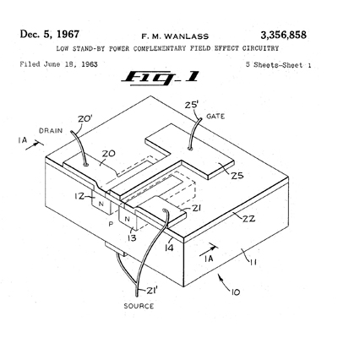
CMOS Circuit
Wanlass, F. M. "Low Stand-By Power Complementary Field Effect Circuitry.“
U. S. Patent 3,356,858 (Filed June 18, 1963. Issued December 5, 1967).
Fall 2008, Sep 26 . . .
ELEC2200-002 Lecture 4

Slide 20
CMOS Logic Gate: Inverter
Power supply
VDD = 1 volt; voltage depends on technology.
A = VDD = 1 volt is state “1”
A = GND = 0 volt is state “0”
Truth Table
A | A
0 | 1
1 | 0
A
A
A
A
Electrical
Circuit
Symbol
GND
Ground
Boolean Function
Fall 2008, Sep 26 . . .
ELEC2200-002 Lecture 4

Slide 21
CMOS Logic Gate: NAND
VDD
Electrical
Circuit
Boolean Function
Truth Table
A | B | F
0 | 0 | 1
0 | 1 | 1
1 | 0 | 1
1 | 1 | 0
Symbol
A
A
F
F
B
B
GND
Fall 2008, Sep 26 . . .
ELEC2200-002 Lecture 4

Slide 22
CMOS Logic Gate: NOR
VDD
Electrical
Circuit
Boolean Function
Truth Table
A | B | F
0 | 0 | 1
0 | 1 | 0
1 | 0 | 0
1 | 1 | 0
Symbol
A
A
F
B
F
B
GND
Fall 2008, Sep 26 . . .
ELEC2200-002 Lecture 4

Slide 23
CMOS Logic Gate: AND
Boolean Function
Truth Table
A | B | F
0 | 0 | 0
0 | 1 | 0
1 | 0 | 0
1 | 1 | 1
Symbol
A
A
≡
F
F
F
B
B
Fall 2008, Sep 26 . . .
ELEC2200-002 Lecture 4

Slide 24
CMOS Logic Gate: OR
Boolean Function
Truth Table
A | B | F
0 | 0 | 0
0 | 1 | 1
1 | 0 | 1
1 | 1 | 1
Symbol
A
A
≡
F
F
F
B
B
Fall 2008, Sep 26 . . .
ELEC2200-002 Lecture 4

Slide 25
CMOS Gates
Logic function | Number of transistors
 | 1 or 2 inputs | N inputs
NOT | 2 | -
AND | 6 | 2N + 2
OR | 6 | 2N + 2
NAND | 4 | 2N
NOR | 4 | 2N
Fall 2008, Sep 26 . . .
ELEC2200-002 Lecture 4

Slide 26
Optimized Ignition Logic
M = K (P + B S)
= KP + KBS
K
KP
P
M
B
S
KBS
3 gates, 20 transistors. Can we reduce transistors?
Fall 2008, Sep 26 . . .
ELEC2200-002 Lecture 4

Slide 27
Further Optimization
M = K (P + B S)
= KP + KBS (Theorem 3, involution)
= KP · KBS (De Morgan’s theorem)
NAND gates
4+6 transistors
K
KP
P
M
B
S
KBS
3 gates, 14 transistors.
Fall 2008, Sep 26 . . .
ELEC2200-002 Lecture 4

Slide 28
Digital Systems
Binary
Arithmetic
Boolean
Algebra
DIGITAL
CIRCUITS
Switching
Theory
Semiconductor
Technology
Fall 2008, Sep 26. . .
ELEC2200-002 Lecture 4

Slide 29
Digital Logic Design
Representation of switching function:
    Truth table
    Canonical forms
    Karnaugh map
Logic minimization: Minimize number of literals.
Technology mapping: Implement logic function using predesigned gates or building blocks from technology library.
Fall 2008, Sep 26 . . .
ELEC2200-002 Lecture 4

Slide 30
Truth Table
Truth table is an exhaustive description of a switching function. Contains 2^{n} input combinations for n variables.
Example: f(A,B,C) = A B +‾A C + A‾C
n Input variables |  |  | Output
A | B | C | f(A,B,C)
0 | 0 | 0 | 0
0 | 0 | 1 | 1
0 | 1 | 0 | 0
0 | 1 | 1 | 1
1 | 0 | 0 | 1
1 | 0 | 1 | 0
1 | 1 | 0 | 1
1 | 1 | 1 | 1
2^{n} rows
Fall 2008, Sep 26 . . .
ELEC2200-002 Lecture 4

Slide 31
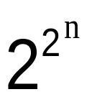
How Many Switching Functions?
Output column of truth table has length 2^{n} for n input variables.
It can be arranged in ways for n variables.
Example: n = 1, single variable.
Input | Output functions
A | F1(A) | F2(A) | F3(A) | F4(A)
0 | 0 | 0 | 1 | 1
1 | 0 | 1 | 0 | 1
Fall 2008, Sep 26 . . .
ELEC2200-002 Lecture 4

Slide 32
Definitions
Boolean variable: A variable denoted by a symbol; can assume a value 0 or 1.
Literal: Symbol for a variable or its complement.
Product or product term: A set of literals, ANDed together. Example, a b‾c.
Cube: Same as a product term.
Sum: A set of literals, Ored together. Example, a + b +‾c.
Fall 2008, Sep 26 . . .
ELEC2200-002 Lecture 4

Slide 33
More Definitions
SOP (sum of products): A Boolean function expressed as a sum of products.
Example: f(A,B,C) = A B +‾A C + A‾C
POS (product of sums): A Boolean function expressed as a product of sums.
Example:
f(A,B,C) = (‾A +‾B +‾C) (‾A + B +‾C) ( A +‾B + C)
Fall 2008, Sep 26 . . .
ELEC2200-002 Lecture 4

Slide 34
Minterm
A product term in which each variable is present either in true or in complement form.
For n variables, there are 2^{n} unique minterms.
Minterm | Product
m₀ | ‾A ‾B‾C
m₁ | ‾A ‾B C
m₂ | ‾A B‾C
m₃ | ‾A B C
m₄ | A ‾B‾C
m₅ | A ‾B C
m₆ | A B ‾C
m₇ | A B C
Fall 2008, Sep 26 . . .
ELEC2200-002 Lecture 4

Slide 35
Minterms are Canonical Functions
1
0
m₀
m₁
m₂
m₃
m₄
m₅
m₆
m₇
Value of minterm
000 001 010 011 100 101 110 111
Input
Fall 2008, Sep 26 . . .
ELEC2200-002 Lecture 4

Slide 36
Canonical SOP Form a.k.a. Disjunctive Normal Form (DNF)
A Boolean function expressed as a sum of minterms.
Example: f(A,B,C) = A B +‾A C + A‾C
= ‾A‾BC +‾ABC + A‾B‾C + AB‾C + ABC
= m₁+m₃+m₄+m₆+m₇ = ∑ m(1, 3, 4, 6, 7)
Row No. | A | B | C | f(A,B,C)
0 | 0 | 0 | 0 | 0
1 | 0 | 0 | 1 | 1
2 | 0 | 1 | 0 | 0
3 | 0 | 1 | 1 | 1
4 | 1 | 0 | 0 | 1
5 | 1 | 0 | 1 | 0
6 | 1 | 1 | 0 | 1
7 | 1 | 1 | 1 | 1
Truth table with row numbers
Fall 2008, Sep 26 . . .
ELEC2200-002 Lecture 4

Slide 37
Maxterm
A summation term in which each variable is present either in true or in complement form.
For n variables, there are 2^{n} unique maxterms.
Maxterm | Product
M₀ | A + B + C
M₁ | A + B +‾C
M₂ | A +‾B + C
M₃ | A +‾B +‾C
M₄ | ‾A + B + C
M₅ | ‾A + B +‾C
M₆ | ‾A +‾B + C
M₇ | ‾A + ‾B + ‾C
Fall 2008, Sep 26 . . .
ELEC2200-002 Lecture 4

Slide 38
Canonical POS Form a.k.a. Conjunctive Normal Form (CNF)
A Boolean function expressed as a product of maxterms.
Example: f(A,B,C) = A B +‾A C + A‾C
= (A + B + C)(A +‾B + C)(‾A + B +‾C)
= M₀ M₂ M₅ = Π M(0, 2, 5)
Row No. | A | B | C | f(A,B,C)
0 | 0 | 0 | 0 | 0
1 | 0 | 0 | 1 | 1
2 | 0 | 1 | 0 | 0
3 | 0 | 1 | 1 | 1
4 | 1 | 0 | 0 | 1
5 | 1 | 0 | 1 | 0
6 | 1 | 1 | 0 | 1
7 | 1 | 1 | 1 | 1
Truth table with row numbers
Fall 2008, Sep 26 . . .
ELEC2200-002 Lecture 4

Slide 39
Canonical Forms are Unique
A canonical form completely defines a Boolean function. That is, for every input the canonical form specifies the value of the function.
To determine canonical form:
    Construct truth table and sum minterms corresponding to 1 outputs, or multiply maxterms corresponding to 0 outputs.
    Alternatively, use Shannon’s expansion theorem (see Section 2.2.3, page 101).
Two Boolean functions are identical if and only if their canonical forms are identical.
Fall 2008, Sep 26 . . .
ELEC2200-002 Lecture 4

Slide 40
Karnaugh Map
1952: Edward M. Veitch invented a graphical procedure for digital circuit optimization.
1953: Maurice Karnaugh perfected the map procedure:
    “The Map Method for Synthesis of Combinational Logic Circuits,” Trans. AIEE, pt I, 72(9):593-599, November 1953.
Fall 2008, Sep 26 . . .
ELEC2200-002 Lecture 4

Slide 41
Karnaugh Map: 2 Variables, A, B
A = 0 A = 1
Unit
Hamming
distance
between
adjacent
cells
B = 0
B = 1
00
10
Each cell is
a minterm
m₀
m₂
01
11
m₃ = AB = 11
(numerical
interpretation)
m₁
m₃
Fall 2008, Sep 26 . . .
ELEC2200-002 Lecture 4

Slide 42
Representing a Function
A = 0 A = 1
Place 1 in cells
corresponding to
minterms in canonical
form
For example, see
F = A B + A‾B
represented on the left.
0
2
B = 0
B = 1
1
m₀
m₂
1
3
1
m₁
m₃
Fall 2008, Sep 26 . . .
ELEC2200-002 Lecture 4

Slide 43
Grouping Adjacent Minterms
A = 0 A = 1
Adjacent cells differ in
one variable, which is
eliminated.
For example,
F = A B + A‾B
= A(B +‾B) = A
0
2
B = 0
B = 1
1
m₀
m₂
1
3
1
m₁
m₃
Product term A
Fall 2008, Sep 26 . . .
ELEC2200-002 Lecture 4

Slide 44
Karnaugh Map Minimization
Canonical SOP form represented on map
Example: F = A‾B + A B +‾A B
Find minimal cover (fewest groups of largest sizes),
F = A + B
A = 0 A = 1
product A
B = 0
B = 1
1
A
F
m₀
m₂
B
1
1
product B
m₁
m₃
Fall 2008, Sep 26 . . .
ELEC2200-002 Lecture 4

Slide 45
Karnaugh Map: 3 Variables, A, B, C
A
0 | 2 | 6 | 4
1 | 3 | 7 | 5
000
010
110
100
C
001
011
111
101
B
Check unit Hamming distance between adjacent cells.
Fall 2008, Sep 26 . . .
ELEC2200-002 Lecture 4

Slide 46
Synthesizing a Digital Function
Start with specification.
Create a truth table from specification.
Minimize (SOP with fewest literals):
    Either write canonical SOP
    Reduce using postulates and theorems
    Or find largest cubes from Karnaugh map
Minimized SOP gives a two-level AND-OR circuit.
NAND or NOR circuit for CMOS technology can be found using de Morgan’s theorem.
Fall 2008, Sep 26 . . .
ELEC2200-002 Lecture 4

Slide 47
Example: Multiplexer
Inputs: A, B, C
Output: F
Function:
    F = A, when C = 1
    F = B, when C = 0
Fall 2008, Sep 26 . . .
ELEC2200-002 Lecture 4

Slide 48
3-Input Function: Multiplexer
B‾C
A
Truth Table
row | A | B | C | F
0 | 0 | 0 | 0 | 0
1 | 0 | 0 | 1 | 0
2 | 0 | 1 | 0 | 1
3 | 0 | 1 | 1 | 0
4 | 1 | 0 | 0 | 0
5 | 1 | 0 | 1 | 1
6 | 1 | 1 | 0 | 1
7 | 1 | 1 | 1 | 1
0 | 2 | 6 | 4
1 | 3 | 7 | 5
1
1
1
1
C
B
A C
F = A C + B‾C
A
C
B
F
Fall 2008, Sep 26 . . .
ELEC2200-002 Lecture 4

Slide 49
Technology Optimization
A
C
B
F = A C + B‾C
F
2+6+6+6 = 20 transistors
A
C
B
F
Fall 2008, Sep 26 . . .
ELEC2200-002 Lecture 4

Slide 50
Optimized Multiplexer
A
C
B
X
F
Y
A
C
B
X
F
Y
2+4+4+4 = 14 transistors
Fall 2008, Sep 26 . . .
ELEC2200-002 Lecture 4

Slide 51
Karnaugh Map: 4 Variables, A, B, C, D
A
0 | 4 | 12 | 8
1 | 5 | 13 | 9
3 | 7 | 15 | 11
2 | 6 | 14 | 10
C
D
B
Check unit Hamming distance between adjacent cells.
Fall 2008, Sep 26 . . .
ELEC2200-002 Lecture 4

